Slide 1
2016 Criminal Justice Conference Court of Criminal Appeals Update
February 22-23 Stacey M. Soule
Sheraton Capitol Hotel Assistant State Prosecuting Attorney

Slide 2
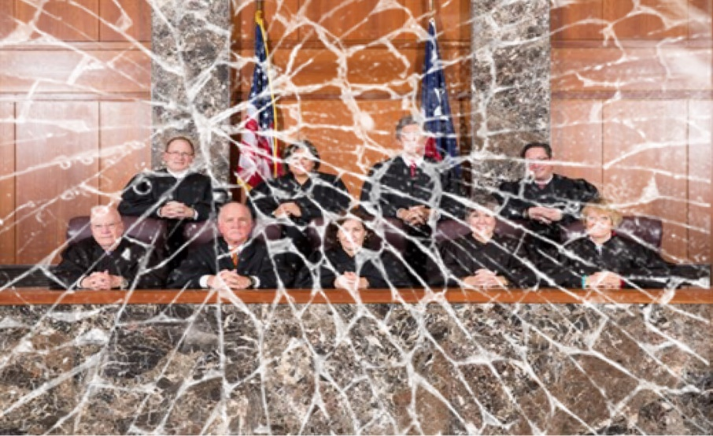

Slide 3
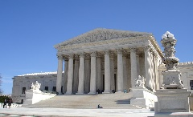
An Exceptional Term . . . And It’s Not Over Yet!
 | Majority | Concurring | Dissenting
Keller | 10 | 1 | 5
Meyers | 5 | 2 | 11
Johnson | 5 | 4 | 3
Keasler | 9 | 3 | 5
Hervey | 8 | 1 | 1
Alcala | 7 | 5 | 8
Richardson | 4 | 9 | 1
Yeary | 3 | 6 | 49
Newell | 4 | 3 | 2
Total | 55 | 34 | 85

Slide 5
Faust v. State, PD-0893/94-15
Arrest of Kingdom of Baptist Church members protesting at Fort Worth’s Gay Pride Parade for interfering with public duties after they disobeyed the police officers’ directive to remain behind time/distance skirmish line did not violate their First Amendment rights to free speech.

Slide 6
Previous Violence
Content Neutral; regulated protected speech to prevent a confrontation
Narrowly Tailored; maintained safety and order based on history
Ample Alternative Channels and Temporary

Slide 7
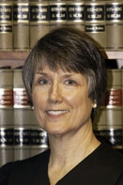
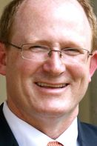
Concurrences
Johnson
Not speech or expressive conduct; self-help not a proper remedy; can be remedied under 1983
Yeary
Not charged for exercising rights but for interfering with public duties; prohibiting self-help, which could cause death or injury, justifies deprivation, even if it can never be fully vindicated in court

Slide 8
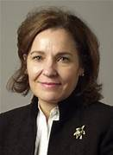
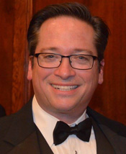
Dissents
Keller
Injunction standard due to ad hoc action, not general law; less restrictive means used in past; strict scrutiny justified because viewpoint- content-based and no injunction procedural protections
Newell
Preservation an issue because as-applied and defense raised and relief requested was acquittal

Slide 9
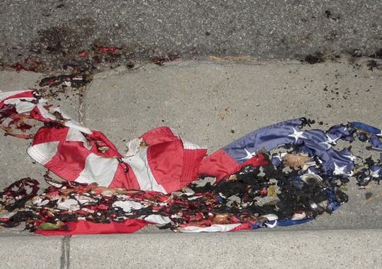
State v. Johnson, No. PD-0228-14
The flag-desecration statute, Penal Code Section 42.11, is overbroad and therefore unconstitutional on its face
Criminal mischief offense not factor in examining legitimate applications
“[U]pholding a statute on the basis that its unconstitutional applications are so glaringly obvious that prosecutors will avoid them and speech will not be chilled by them” stands First Amendment law on its head

Slide 10
Dissent
Yeary
Standing is a matter of state law, and the relaxed standing requirement is not a part of the substantive overbreadth doctrine; should have to show unconstitutional as-applied
Only a violation in some circumstances
Conduct in addition to intent to communicate before First Amendment implicated
Reduced chance of unconstitutional applications because of stricken statutes

Slide 11
Perry, PD-1067-15
Pretrial habeas cognizability of challenges under speech and debate, legislative immunity, and separation of powers
Facial overbreadth of “threat” in the coercion of public servant statute

Slide 12
Ex parte Fournier, WR-82,102/03-01
Ex parte Lo, holding part of the online solicitation of a minor statute overbroad, does not provide a basis for an actual innocence claim on habeas
Removal of sanctions does not change past conduct committed
Overly broad statute claim not subject to procedural default
Resembles Schlup v. Delo gateway actual innocence

Slide 13
Dissent
Yeary
Ex parte Lo should not be applied retroactively unless it was unconstitutional as-applied
Windfall if within the statute’s legitimate sweep, compared to traditional facial challenge
Invalidity prospectively serves overbreadth doctrine by removing chilling

Slide 14
In re Allen, No. 10-0886 Texas S. Ct.: Texas Wrongful Imprisonment Act permits compensation for Herrera (straight) and Schlup innocence claims
Fournier entitled to compensation?
Subsequent writ like Ex parte Milner, 394 S.W.3d 502 (Tex. Crim. App. 2013), double jeopardy Schlup, gateway; disparate treatment?
Ex parte Reed, WR-80,875-02-Improper Photography, indictment dismissed

Slide 16
Ex parte Marascio, Nos. WR-80,939-01/03
Double Jeopardy concerning bail jumping and failure to appear
Concurrences and Dissents
Tension between cognizability & preservation
Alcala, concurring: In light of the procedural similarities between Schlup actual innocence and jeopardy, they should be treated the same for purposes of cognizability
Units of prosecution

Slide 17
Ex parte Reyes, PD-1277-14
Claims which provide the greatest form of relief must be addressed and disposed of before claims offering a lesser form of relief.
Notes:
Trail court addressed and recommended granting relief on a Padilla claim. Failed to address actual innocence. Court concluded trial court erred in its resolution b/c Padilla not retroactive.

Slide 18
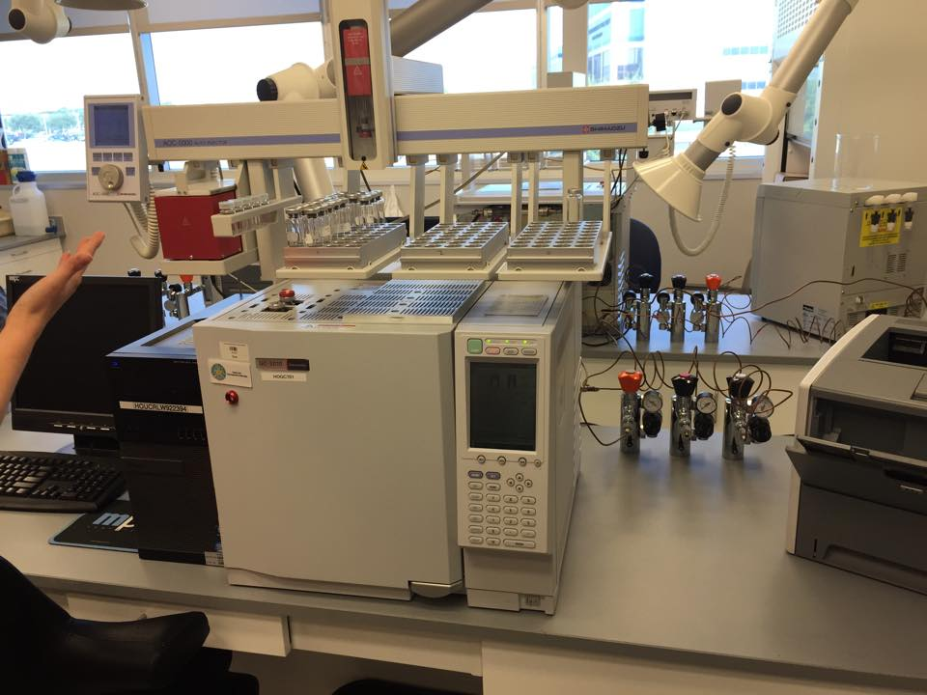
Ex parte Barnaby, WR-80,099-01
Harm Standard for use of Material False Evidence
Non-Guilty Plea:
Whether there is a reasonable likelihood that the false evidence affected the factfinder’s judgment.
NEW RULE for Guilty Plea:
Whether, having known the evidence was false, there is a reasonable likelihood (preponderance of the evidence) that the defendant would have still pled guilty.

Slide 19
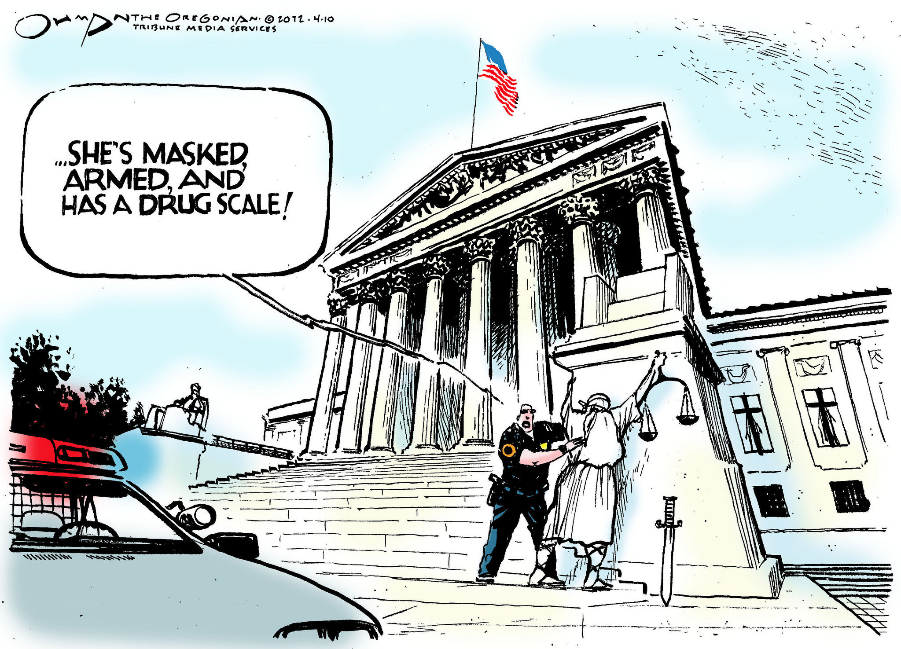
Search and Seizure

Slide 20
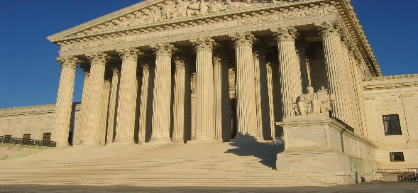
State v. Villarreal, PD-0303-14 (Part Deux)
5/4 = 10/8
A warrantless blood-draw conducted under the repeat-offender provision to the implied consent, mandatory blood draw statute, Tex. Trans. Code § 724.12(b), violates the Fourth Amendment
Next Stop . . .

Slide 21
Residual Issues
Preservation
Douds v. State, PD-0857-14
Isolated statements in suppression motion blood draw without a warrant insufficient
Motion to suppress, arguments, and post-hearing briefing challenged whether the requirements of the blood-draw statute had been met

Slide 22
Pending: Clement, PD-0681: “Does a suppression motion’s mere citation to the Fourth Amendment and probable cause, or a belated closing argument that anything after the “stop” be suppressed due to lack of probable cause for “arrest,” preserve an illegal arrest claim?”
Preservation as of January 27, 2016 in Blood-Draw Cases
Remanded: Moser, PD-0662-15; Richards, PD-0731-15
Refused: Perez, PD-0577-15; Leal, PD-0836-15 (after remand for COA to address preservation)

Slide 23
Remedy, Tex. Code Crim. Proc. art. 38.23,
and Harm as of January 27, 2016
Pending: Cole, PD-0077-15: If a warrantless blood draw conducted pursuant to Tex. Trans. Code § 724.012(b) violates the Fourth Amendment, must that evidence be suppressed when, at the time of the search, the statute was presumptively valid and dispensed with the warrant requirement?
Refused 38.23 issue with prejudice: Moser, PD-0662-15
Summarily refused remaining cases with 38.23 issue
Summarily refused 2 PDRs raising harmless error

Slide 24
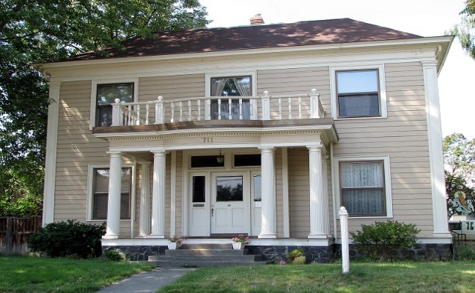
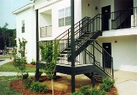
House v. Apartment
State v. Rendon, PD-0013-15
Under the Florida v. Jardines, 133 S. Ct. 1409 (2013), property-rights doctrine, the Fourth Amendment is violated when a drug-detection dog is used to sniff the threshold area of the front door of an apartment located on a semi-private landing.

Slide 25
Dissent
Yeary
No right to exclude; fully available to the public so no intimate use and privacy necessary to establish curtilage under either the property- or privacy-based doctrines
Justice Kagan’s view that there is a search even if the dog is not on the curtilage is not consistent with prior cases that a dog-sniff is not a search

Slide 26
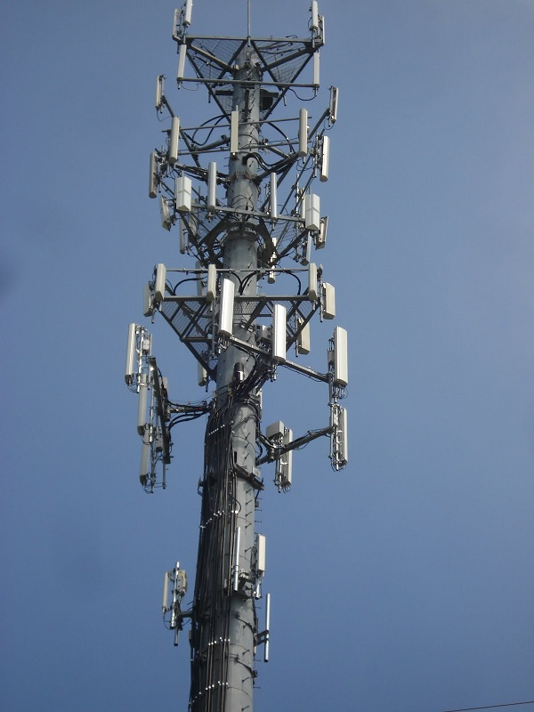
Ford v. State, No. PD-1369-14
The Fourth Amendment is not violated when law enforcement obtains four days of passive historical cell-site-location data without a warrant or probable cause. No reasonable expectation of privacy in location data collected by a third-party carrier for business purposes.

Slide 27
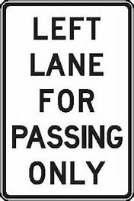
Jaganathan v. State, No. PD-1189-14
Stop supported by reasonable suspicion when the Trooper observed Appellant driving in the left-hand lane, without passing any vehicles in the middle lane, for approximately 15-20 seconds after passing a “Left Lane for Passing” only sign.
“[A] defense would matter only if the facts establishing it were so obvious that an objective officer viewing the situation would be unreasonable in failing to realize that the person’s conduct was allowed by the law.”

Slide 28
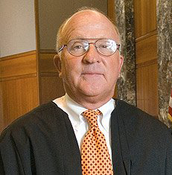
Dissent
Meyers
The sign (in conjunction with the law requiring compliance with road signs) does not provide sufficient notice of the prohibited conduct.
“Is a driver required to actually pass another vehicle while in the left lane?” “Is there a specific amount of time in which this pass must occur?” “What if a driver never comes upon cars to pass, but intended to pass any that were on the roadway?”

Slide 29
Sufficiency

Slide 30
Liverman v. State, Nos. PD-1595/96-14
“[F]iling and recording” a false mechanic’s lien by a county clerk did not constitute causing “another” (i.e. clerk) to “execute” it for purposes of securing the execution of documents by deception under Tex. Penal Code § 32.46(a)(1)
The person filing it brings it into its legal, enforceable status

Slide 31
Cornwell v. State, No. PD-1501-14
Impersonating a Public Servant, Tex. Penal Code § 37.11(a)(1), requires the State to prove, in part: (1) the conduct of impersonation of a public servant and (2) the specific intent to induce another to rely on his pretended official act
The “pretended official act” does not require an actus reus beyond “impersonation”
However, to satisfy the intent element, the State will likely need to put on evidence of “a pretended official act”

Slide 32
Donaldson v. State, Nos. PD-0572/73-14
The COA erred to imply a finding of true to a punishment enhancement by virtue of the defendant’s plea of true when the trial court specifically declined to make a finding based on doubts about the propriety of using the prior for enhancement.

Slide 33
Factual Sufficiency? Walker, PD-1429-14 & PD-1430-14
“The Court of Appeals erred in finding legally sufficient evidence in this case, and allows this Court to reexamine the issue of factually sufficient evidence from Brooks v. State, 323 S.W.3d 893 (Tex. Crim. App. 2010).”
“The Court of Appeals erred in allowing a speculative verdict to stand in contrast to this Court’s instructions.”

Slide 34
Procedure

Slide 35
State v. Wachtendorf, PD-0280-15
State no notice that appealable order was signed until it was “file-stamped” by the district clerk
Plurality re-affirmed that notice of appeal must be made within 20 days of “signing”
Newell concurring
Dismiss as improvidently granted because COA correct

Slide 36
Ex parte Cooke, WR-81,360-01
The “collateral consequences” requirement resulting from a “final conviction” for purposes of Article 11.07 habeas relief is not satisfied when (1) the primary conviction challenged discharged and (2) the primary conviction was enhanced by an offense for which the applicant was on deferred at the time it was used to enhance.

Slide 37
Jury Charge

Slide 38
Beltran v. State, No. PD-1076-14
Appellant was being sexually assaulted by the victim; Appellant’s friend then stabs victim while Appellant held him
Whose conduct is considered for Sudden Passion Appellant’s or friend’s ? ?
“[T]he derivative aspect of the law of parties (criminal responsibility for the conduct of another) does not factor into whether a defendant is entitled to an instruction on sudden passion”

Slide 39
Marshall v. State, No. PD-0510-14
Assault: intentionally, knowingly, recklessly causes bodily injury to another
3rd degree felony romantic partner enhancement: intentionally, knowingly, recklessly impedes normal breathing or circulation by applying pressure to throat or neck or blocking nose or mouth
Impeding normal breathing causes bodily injury per se

Slide 40
Dissent
Yeary
If majority is correct, then there is no charge error
Impeding breathing will not invariably cause bodily injury; likewise, impediment does not always amount to an impairment
The evidence was sufficient under strangulation; the indictment alleged he impeded “circulation of the blood” in addition to normal breathing

Slide 41
Green v. State, PD-0738
Jury charge for aggravated sexual assault cannot include evidentiary sufficiency non-statutory definitions of “penetration” and “female sexual organ”
The COA erred to find “some” harm

Slide 42
Competency

Slide 43
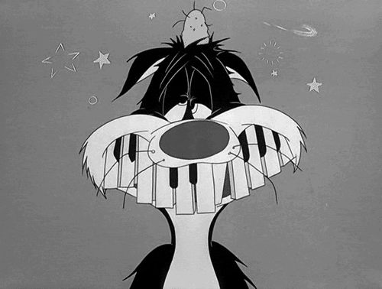
Owens v. State, PD-0967-14 Competency to Stand Trial
6th COA: error because expert not qualified under statute, harm, granted new trial
CCA: assumed error, no harm because not enough evidence that amnesia rendered him unable to confer with counsel or understand the charge
Remedy: COA applied the wrong remedy; proper to remand to determine whether retrospective competency is feasible and, if so, hold a hearing

Slide 44
IN RE THE STATE OF TEXAS EX REL. JOHN F. HEALEY, JR. DISTRICT ATTORNEY, 268TH JUDICIAL DISTRICT, WR-82,875-01/02 (pending)
“Must a defendant be presently competent in order for a retrospective competency trial to occur?”
“If so, does a trial court have the authority to require a jury to determine the issue of present competency?”

Slide 45
Mays v. State, No. AP-77,055 Competency to be Executed
De novo review of a trial court’s determination as to whether a defendant has made a substantial showing of incompetency with Tex. Code Crim. Proc. art. 46.05 and due process were properly applied by considering only evidence of incompetency
Defined the meaning of “responsive pleading” to include a non-adversarial pleading that may be filed by anyone

Slide 46
Mental Retardation or Intellectual Disability

Slide 47
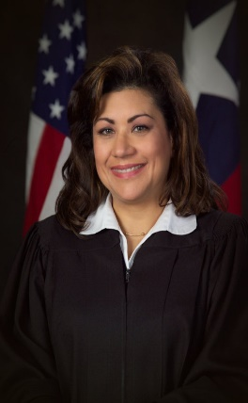
Ex parte Moore, No. WR-13,374-05
Despite recent changes in the medical community regarding the diagnostic criteria for assessing intellectual disability, the Ex parte Briseno, 135 S.W.3d 1 (Tex. Crim. App. 2004), standard will continue to apply for purposes of determining death-sentence eligibility
Alcala, J., dissenting: the new standards recognized by the medical community should be used instead of Ex parte Briseno, which has received criticism, and courts should analyze the medical diagnosis apart from whether a death sentence would constitute cruel and unusual punishment

Slide 48
Expert Testimony

Slide 49
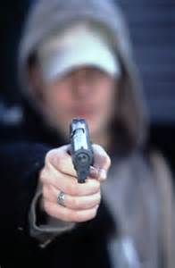
Blasdell v. State, No. PD-0162-14
no showing weapon-focus-effect theory has been generally recognized as a valid hypothesis
failed to show (clear and convincing evidence) that the expert’s methodology, based on self-education, relied upon or used scientific principles in the field
lack of published articles or studies of his own; eye-witness identification generally not enough

Slide 50
Ex parte Robbins, WR-73,484-02, Reh’g denied January 27, 2016
A change in the medical examiner’s opinion about the manner of the victim-child’s death from “homicide” to “undetermined” years after trial constituted “newly available scientific evidence” under Tex. Code Crim. Proc. art. 11.073 that established, by a preponderance of the evidence, that the defendant would not have been convicted if it had been presented at trial.

Slide 51
Wolfe, PD-0292-15 (pending) Shaken-Baby Syndrome
State’s Expert: a “triad” or “constellation” of symptoms—subdural hematoma, retinal hemorrhages, and brain swelling—may support an abusive head trauma diagnosis in the absence of external injuries
Wolfe’s Expert: abusive head trauma has been the most disputed medical topic he has encountered and the boy’s injuries resulted from a birth-related hematoma

Slide 52
Thank you
Stacey M. Soule
Assistant State Prosecuting Attorney
Stacey.Soule@spa.texas.gov

